Slide 1
Spring MVC

Slide 2
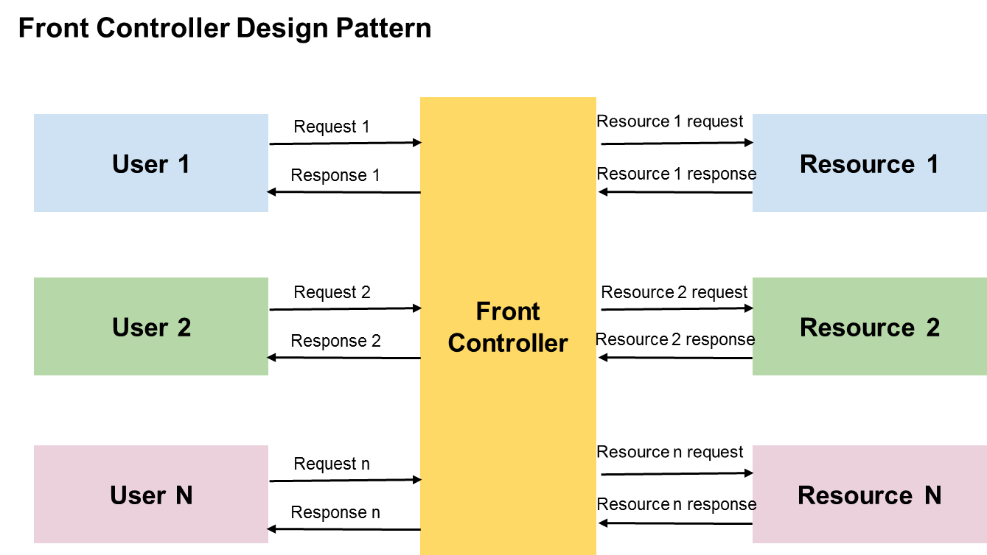
Notes:
Front Controller design pattern.
It enforces a single point of entry for all the incoming requests. All the requests are handled by a single piece of code which can then further delegate the responsibility of processing the request to further application objects.

Slide 3
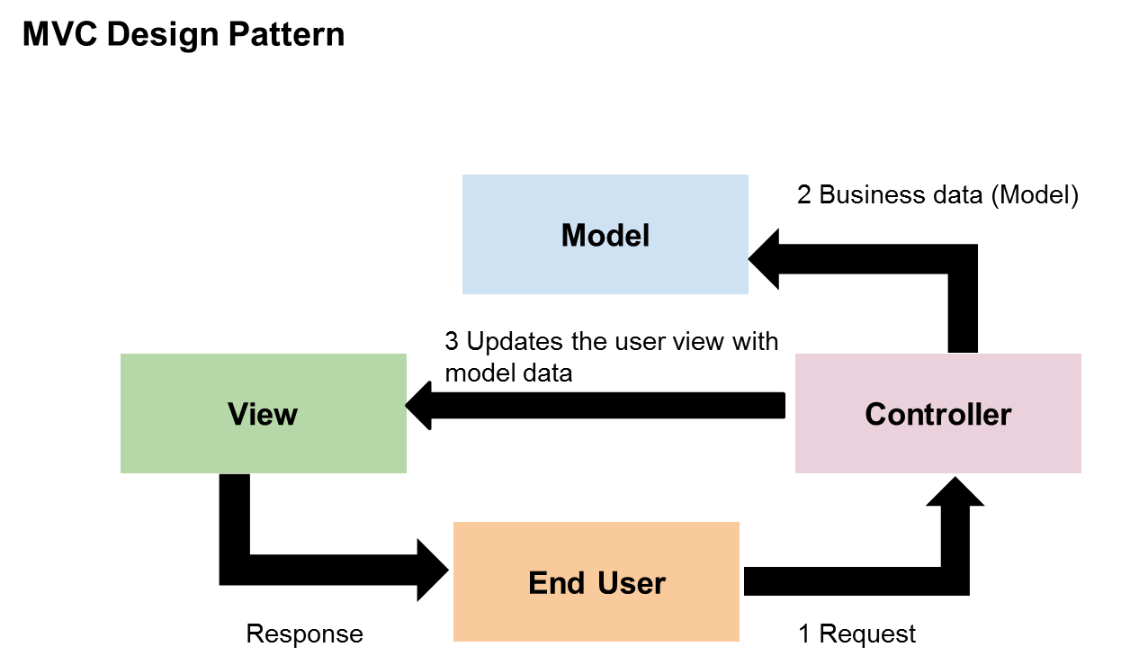
Notes:
MVC is a design pattern that provides a solution to layer an application by separating Business(Model), Presentation(View), and Control Flow(Controller). The model represents the application data. View represents the application’s user interface. The view takes the model as the input and renders it appropriately to the end-user. The controller is responsible for handling the request and generating the model and selecting the appropriate view for the request.

Slide 4
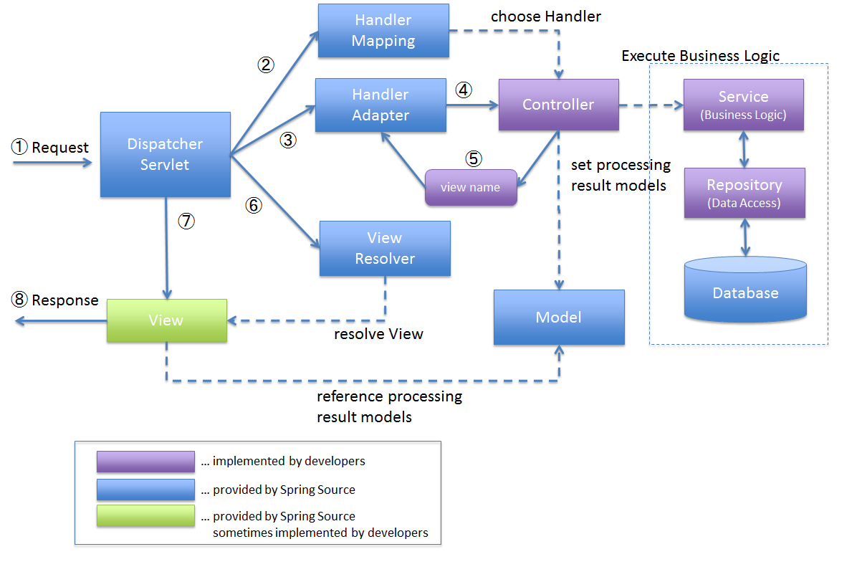
Notes:
DispatcherServlet receives the request.
DispatcherServlet dispatches the task of selecting an appropriate controller to HandlerMapping. HandlerMapping selects the controller which is mapped to the incoming request URL and returns the (selected Handler) and Controller to DispatcherServlet.
DispatcherServlet dispatches the task of executing of business logic of Controller to HandlerAdapter.
HandlerAdapter calls the business logic process of Controller.
Controller executes the business logic, sets the processing result in Model and returns the logical name of view to HandlerAdapter.
DispatcherServlet dispatches the task of resolving the View corresponding to the View name to ViewResolver. ViewResolver returns the View mapped to View name.
DispatcherServlet dispatches the rendering process to returned View.
View renders Model data and returns the response.

